Slide 1
Grassland indicator species vocabulary

Slide 2
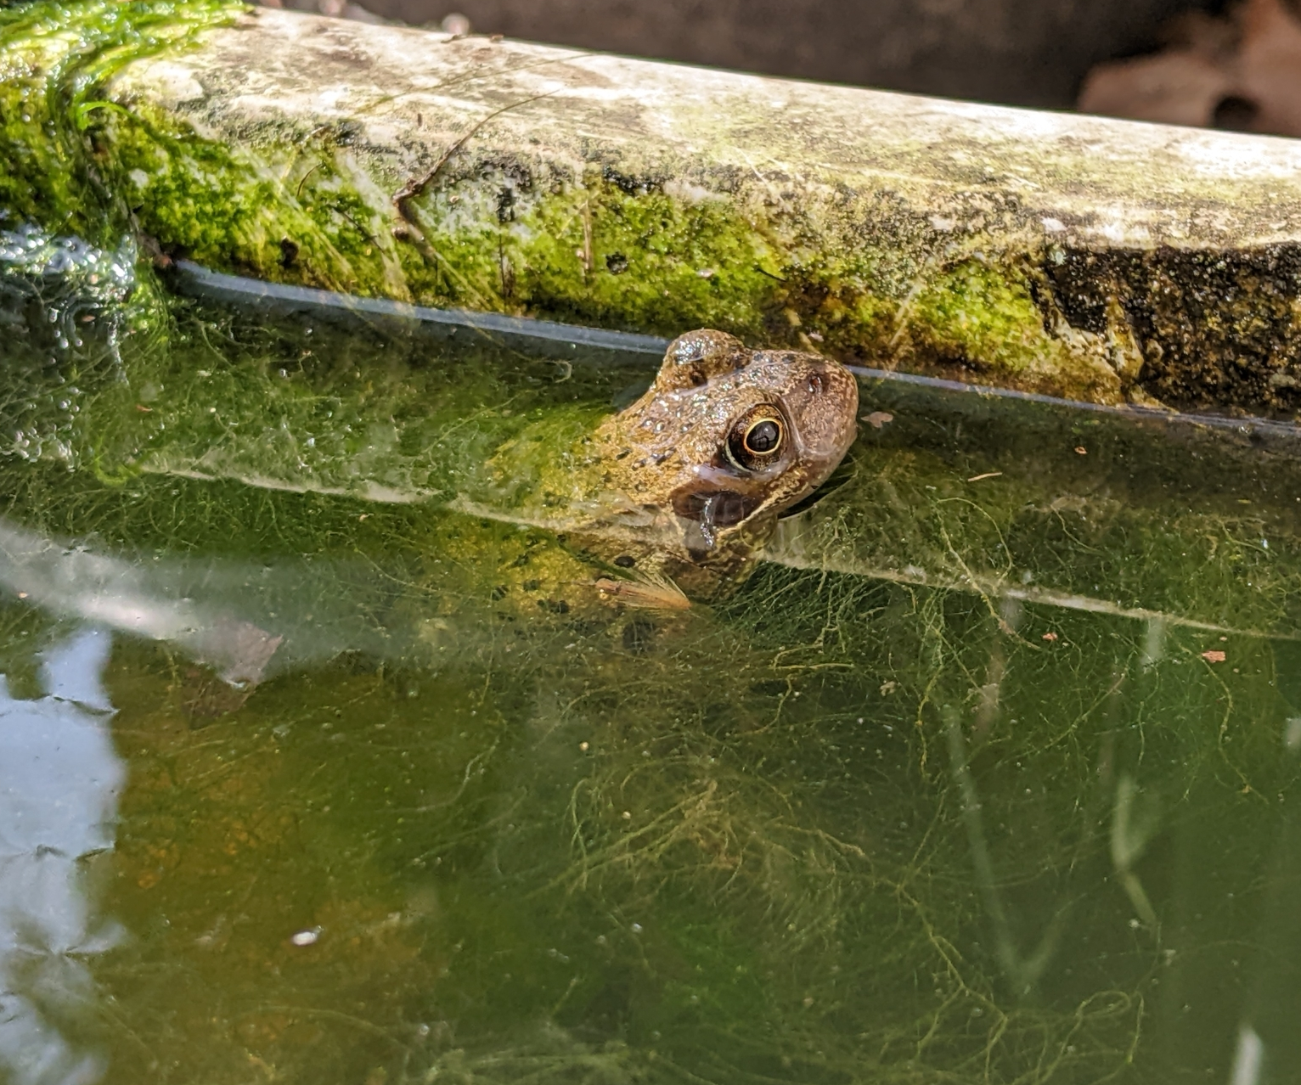
Indicator species
An organism whose presence, absence, or population size tells us something about the environment or ecosystem.
Example
A frog can tell us that there may be a pond in the area. A healthy population of frogs is a good indication that the pond ecosystem is also healthy.
Notes:
To indicate is to show something or point something out. An indicator species points to some information about the habitat or ecosystem.

Slide 3
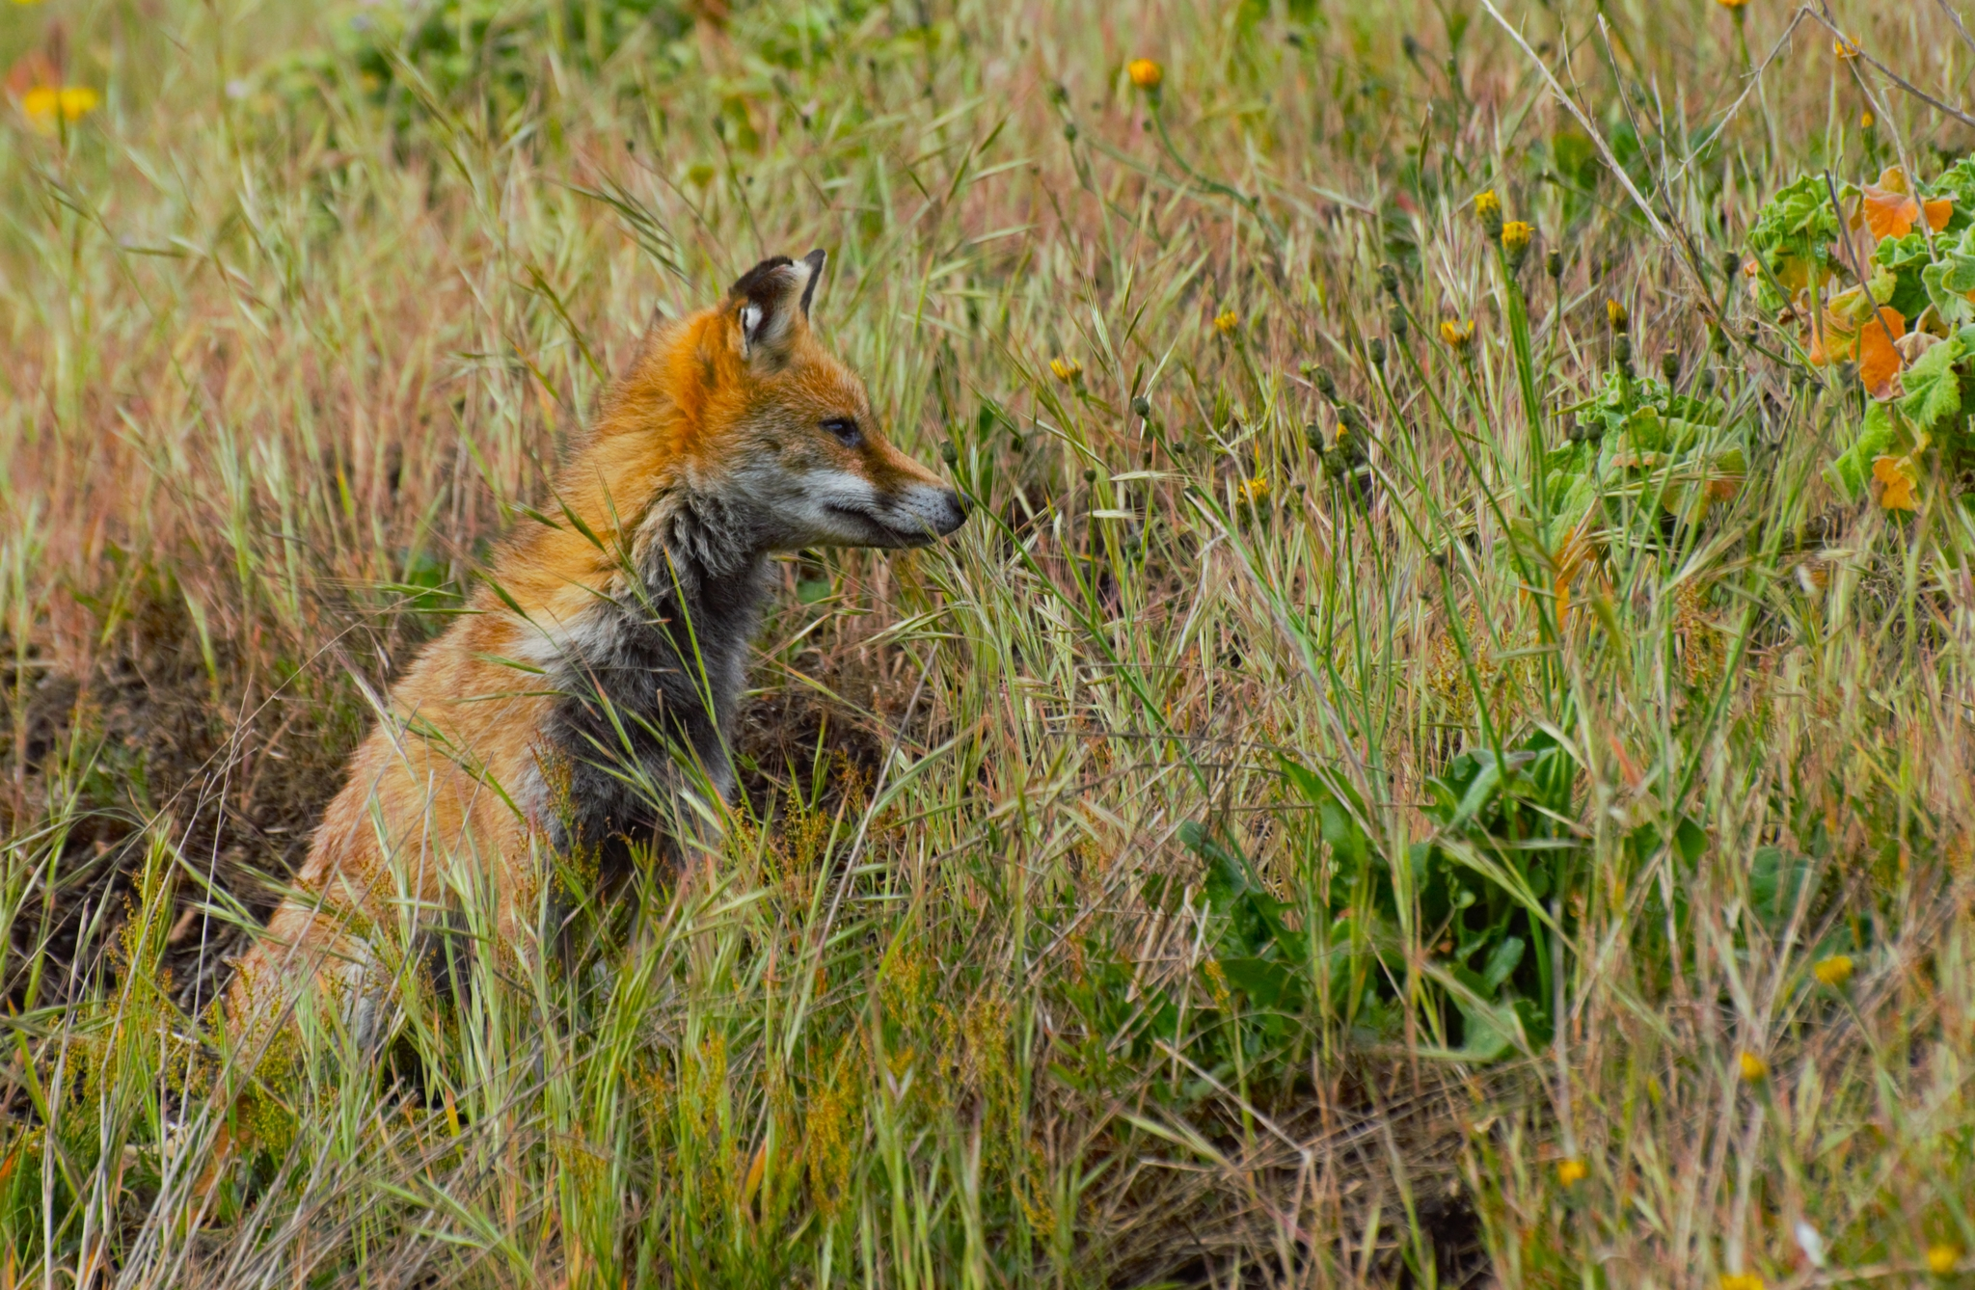
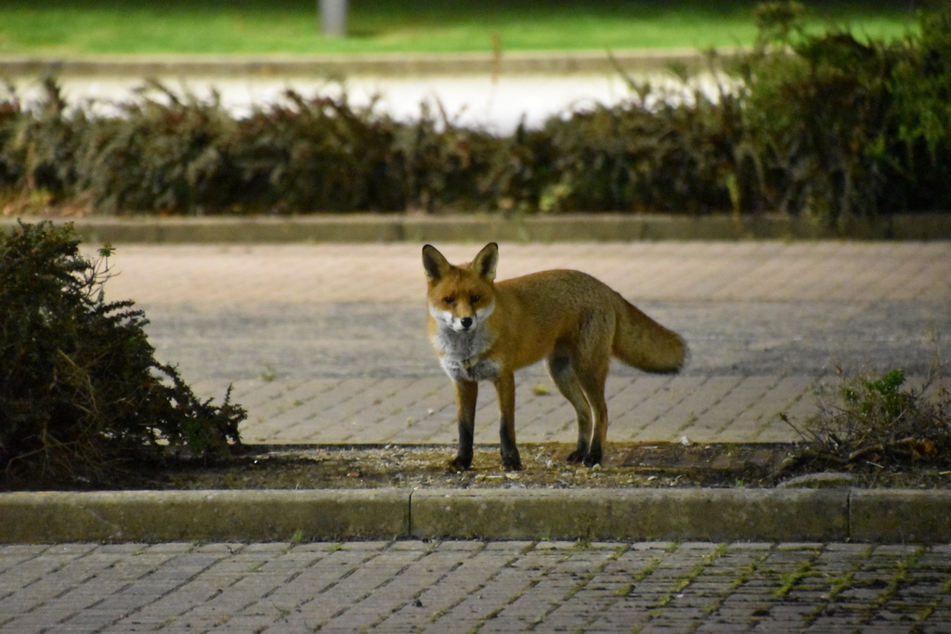
Generalists
Fox in a meadow
Organisms which can live and reproduce in a wide range of habitats.
Example
Foxes can live in forests, grasslands, urban and rural areas.
Fox in a carpark

Slide 4
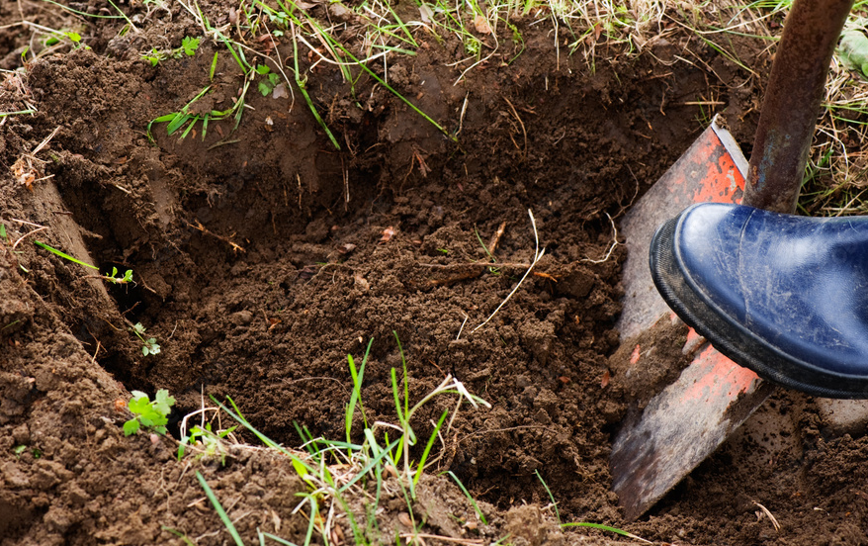
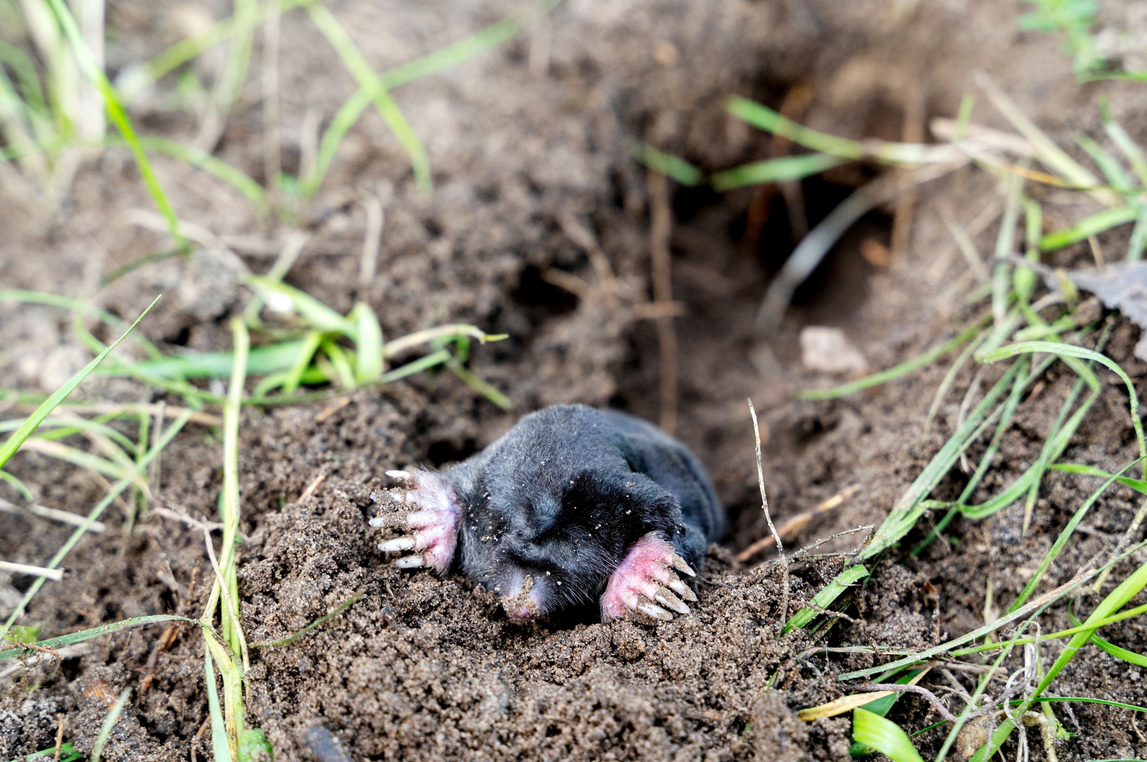
Disturbance
Something that breaks up the soil surface.
Examples
Digging with a shovel.
A mole digging its burrows.

Slide 5
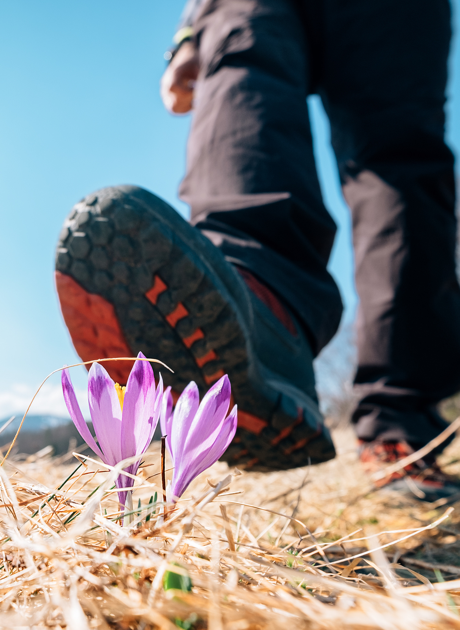
Trampling
Stepping on something.
In ecology and horticulture, trampling usually refers to stepping on soil or plants and how this affects the plants.
Some plants are sensitive to trampling. Their stems become broken or crushed, and the plant can die.
Some plants are tolerant of trampling. These plants can bounce back or regrow after they are crushed.

Slide 6
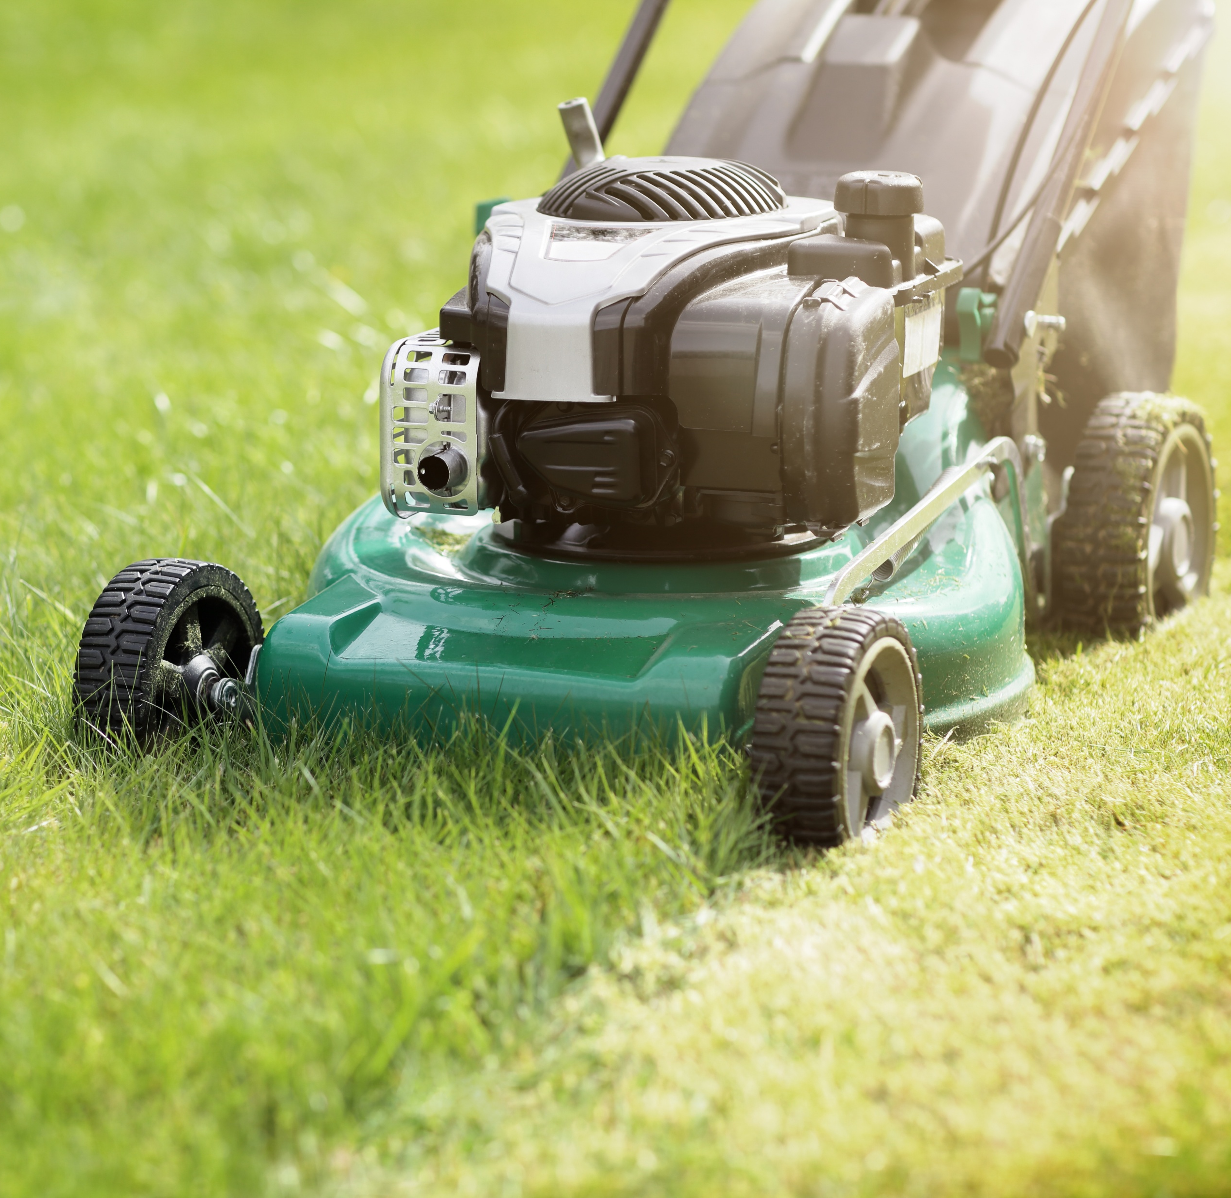
Mowing
Cutting grass shorter, usually with a machine.
Different methods for keeping grass and vegetation short have different impacts on a grassland ecosystem.* Some other ways humans keep grass short include:
grazing with domesticated animals such as cows or sheep
cutting with a scythe
Notes:
Mowing can also result in:
Very even vegetation height.
Removal of nutrients (if cuttings are collected in a bag).
Inability for some plants and animals to complete their lifecycles. Flowers can be cut off taller growing plants. Some insects lay their eggs or pupate on of in grasses and plant stems.
Grazing can also result in:
Uneven grass and vegetation height.
Animal footprints and uneven soil surfaces. These can help with water retention. Instead of flowing off the land, water can collect in the footprints and soak into the ground.
Dung. Decomposition of dung returns nutrients to the soil, and supports a wide variety of insects such as dung beetles.
Scything can also result in:
Less frequent cutting (because it is manual), which can allow more plants and wildlife to complete their lifecycles.
More time for wildlife to move out of the way. Scything is slower than mowing.
Spreading seeds. The cut plants are often left in place for a while before collection, giving time for seeds to drop from plants.

Slide 7
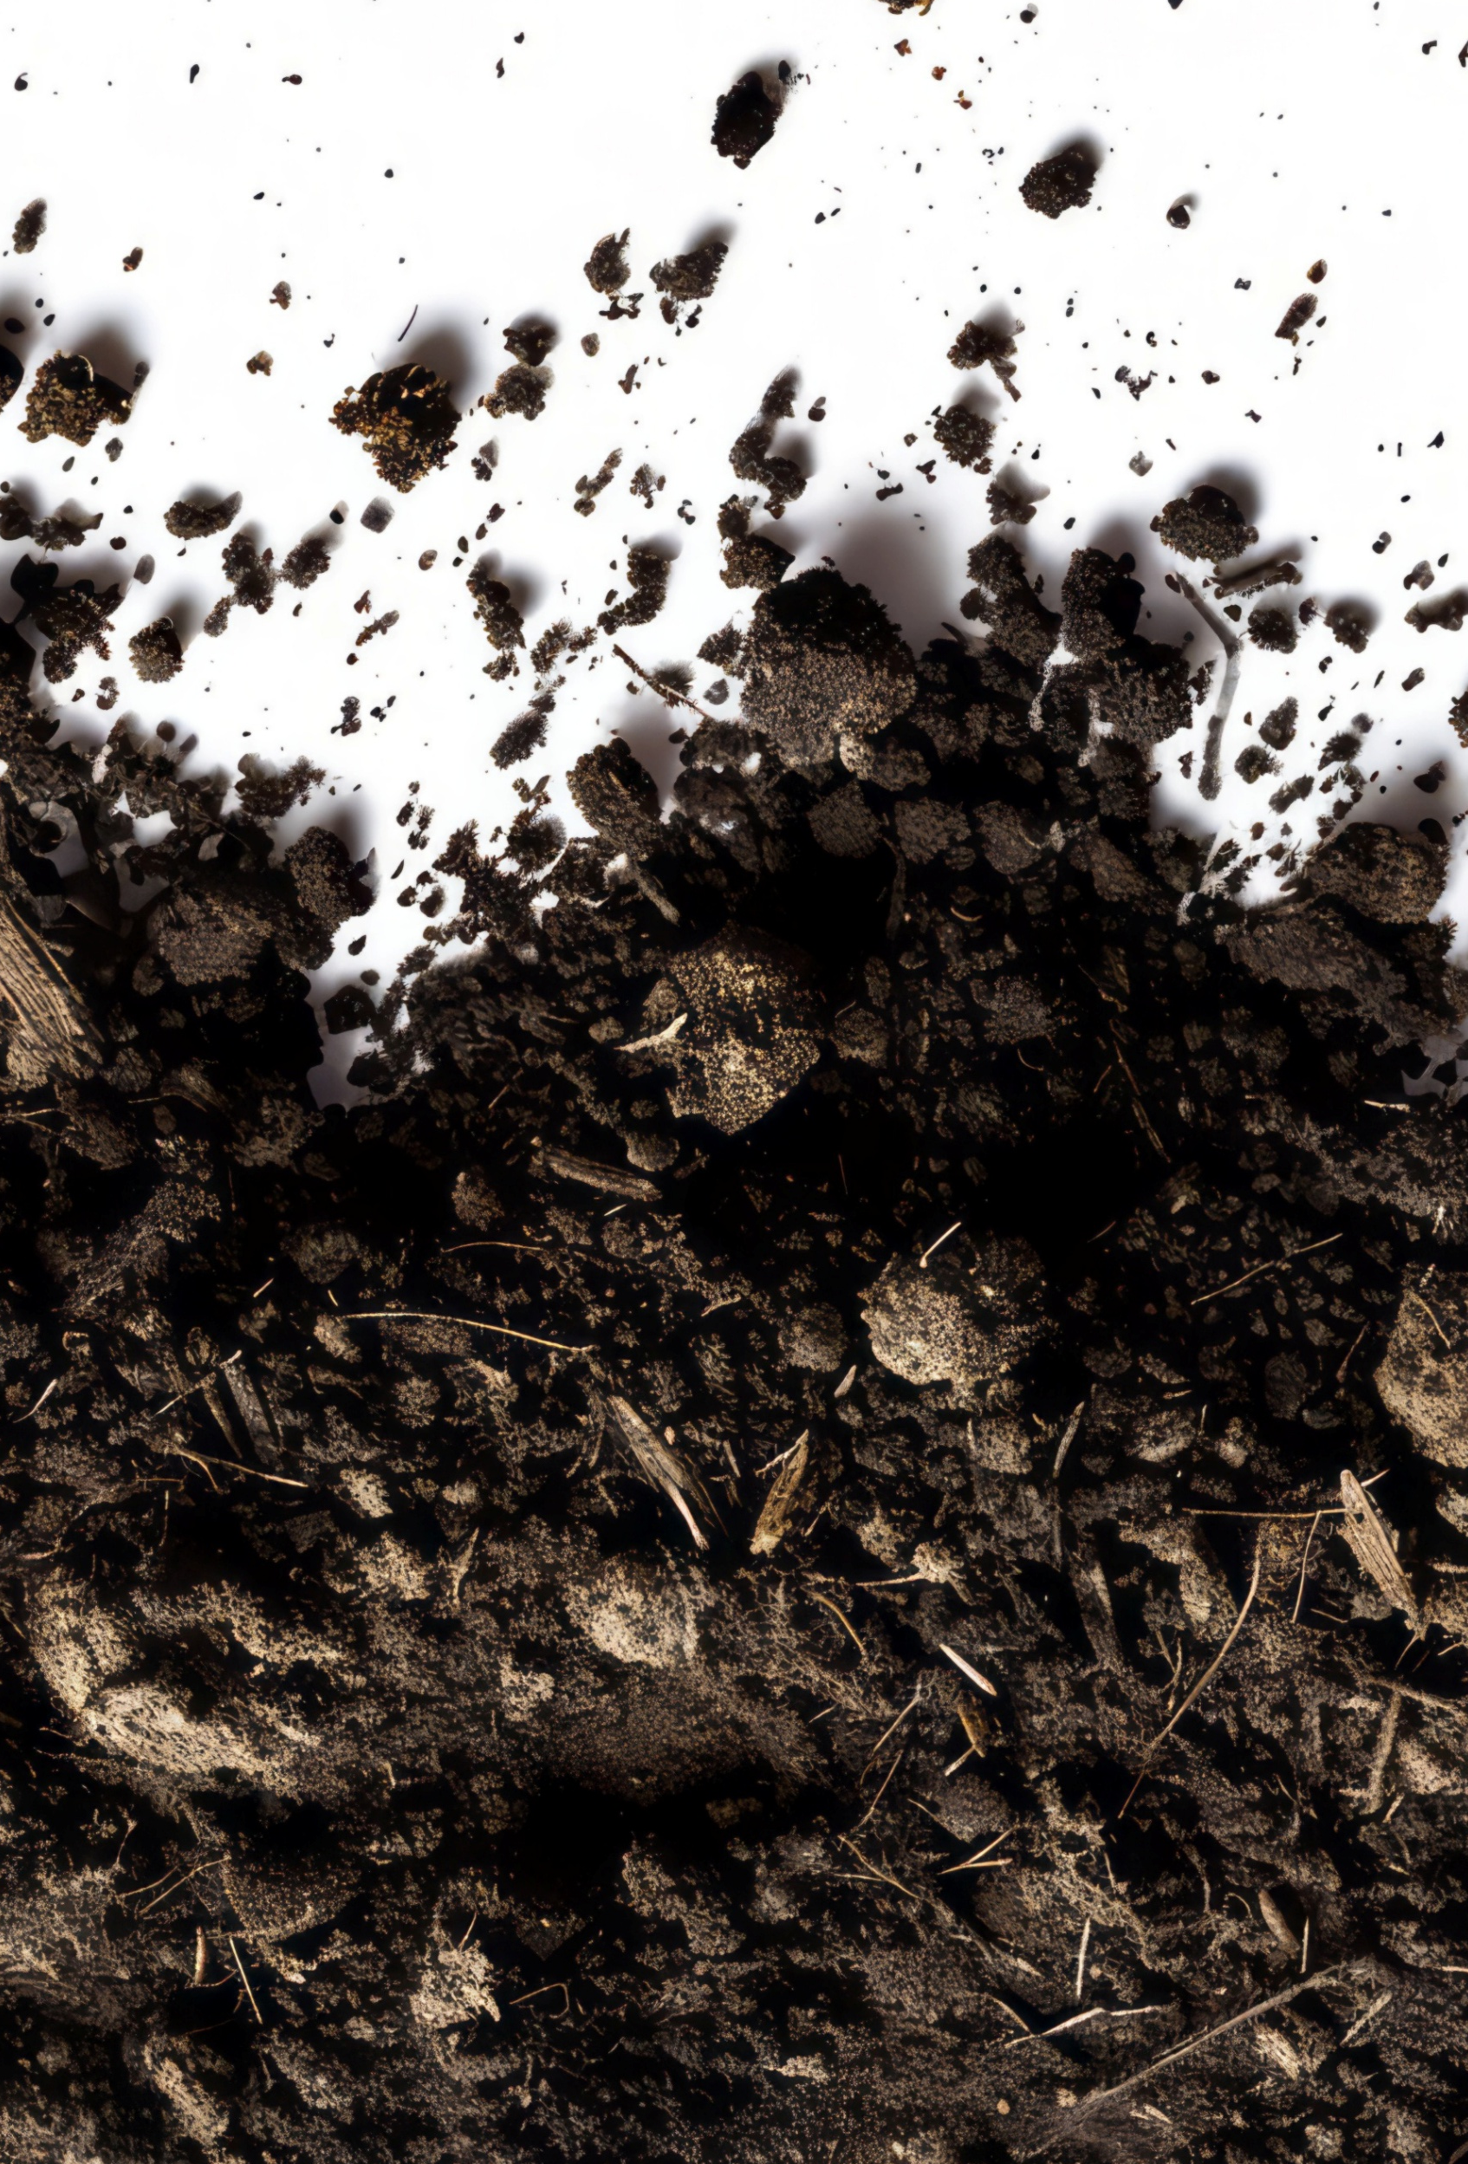
Compaction
Less compacted soil particles
Squashing together soil particles. This reduces the rate at which air and water can move through the soil.
Demonstration
Fill a measuring cup with loose flour, sand, or potting soil. Press down on the material firmly.
The level of the surface goes down because the particles are squeezed together (compacted). The smaller spaces between the particles slows the rate at which water and air move through the soil.
More compacted soil particles

Slide 8
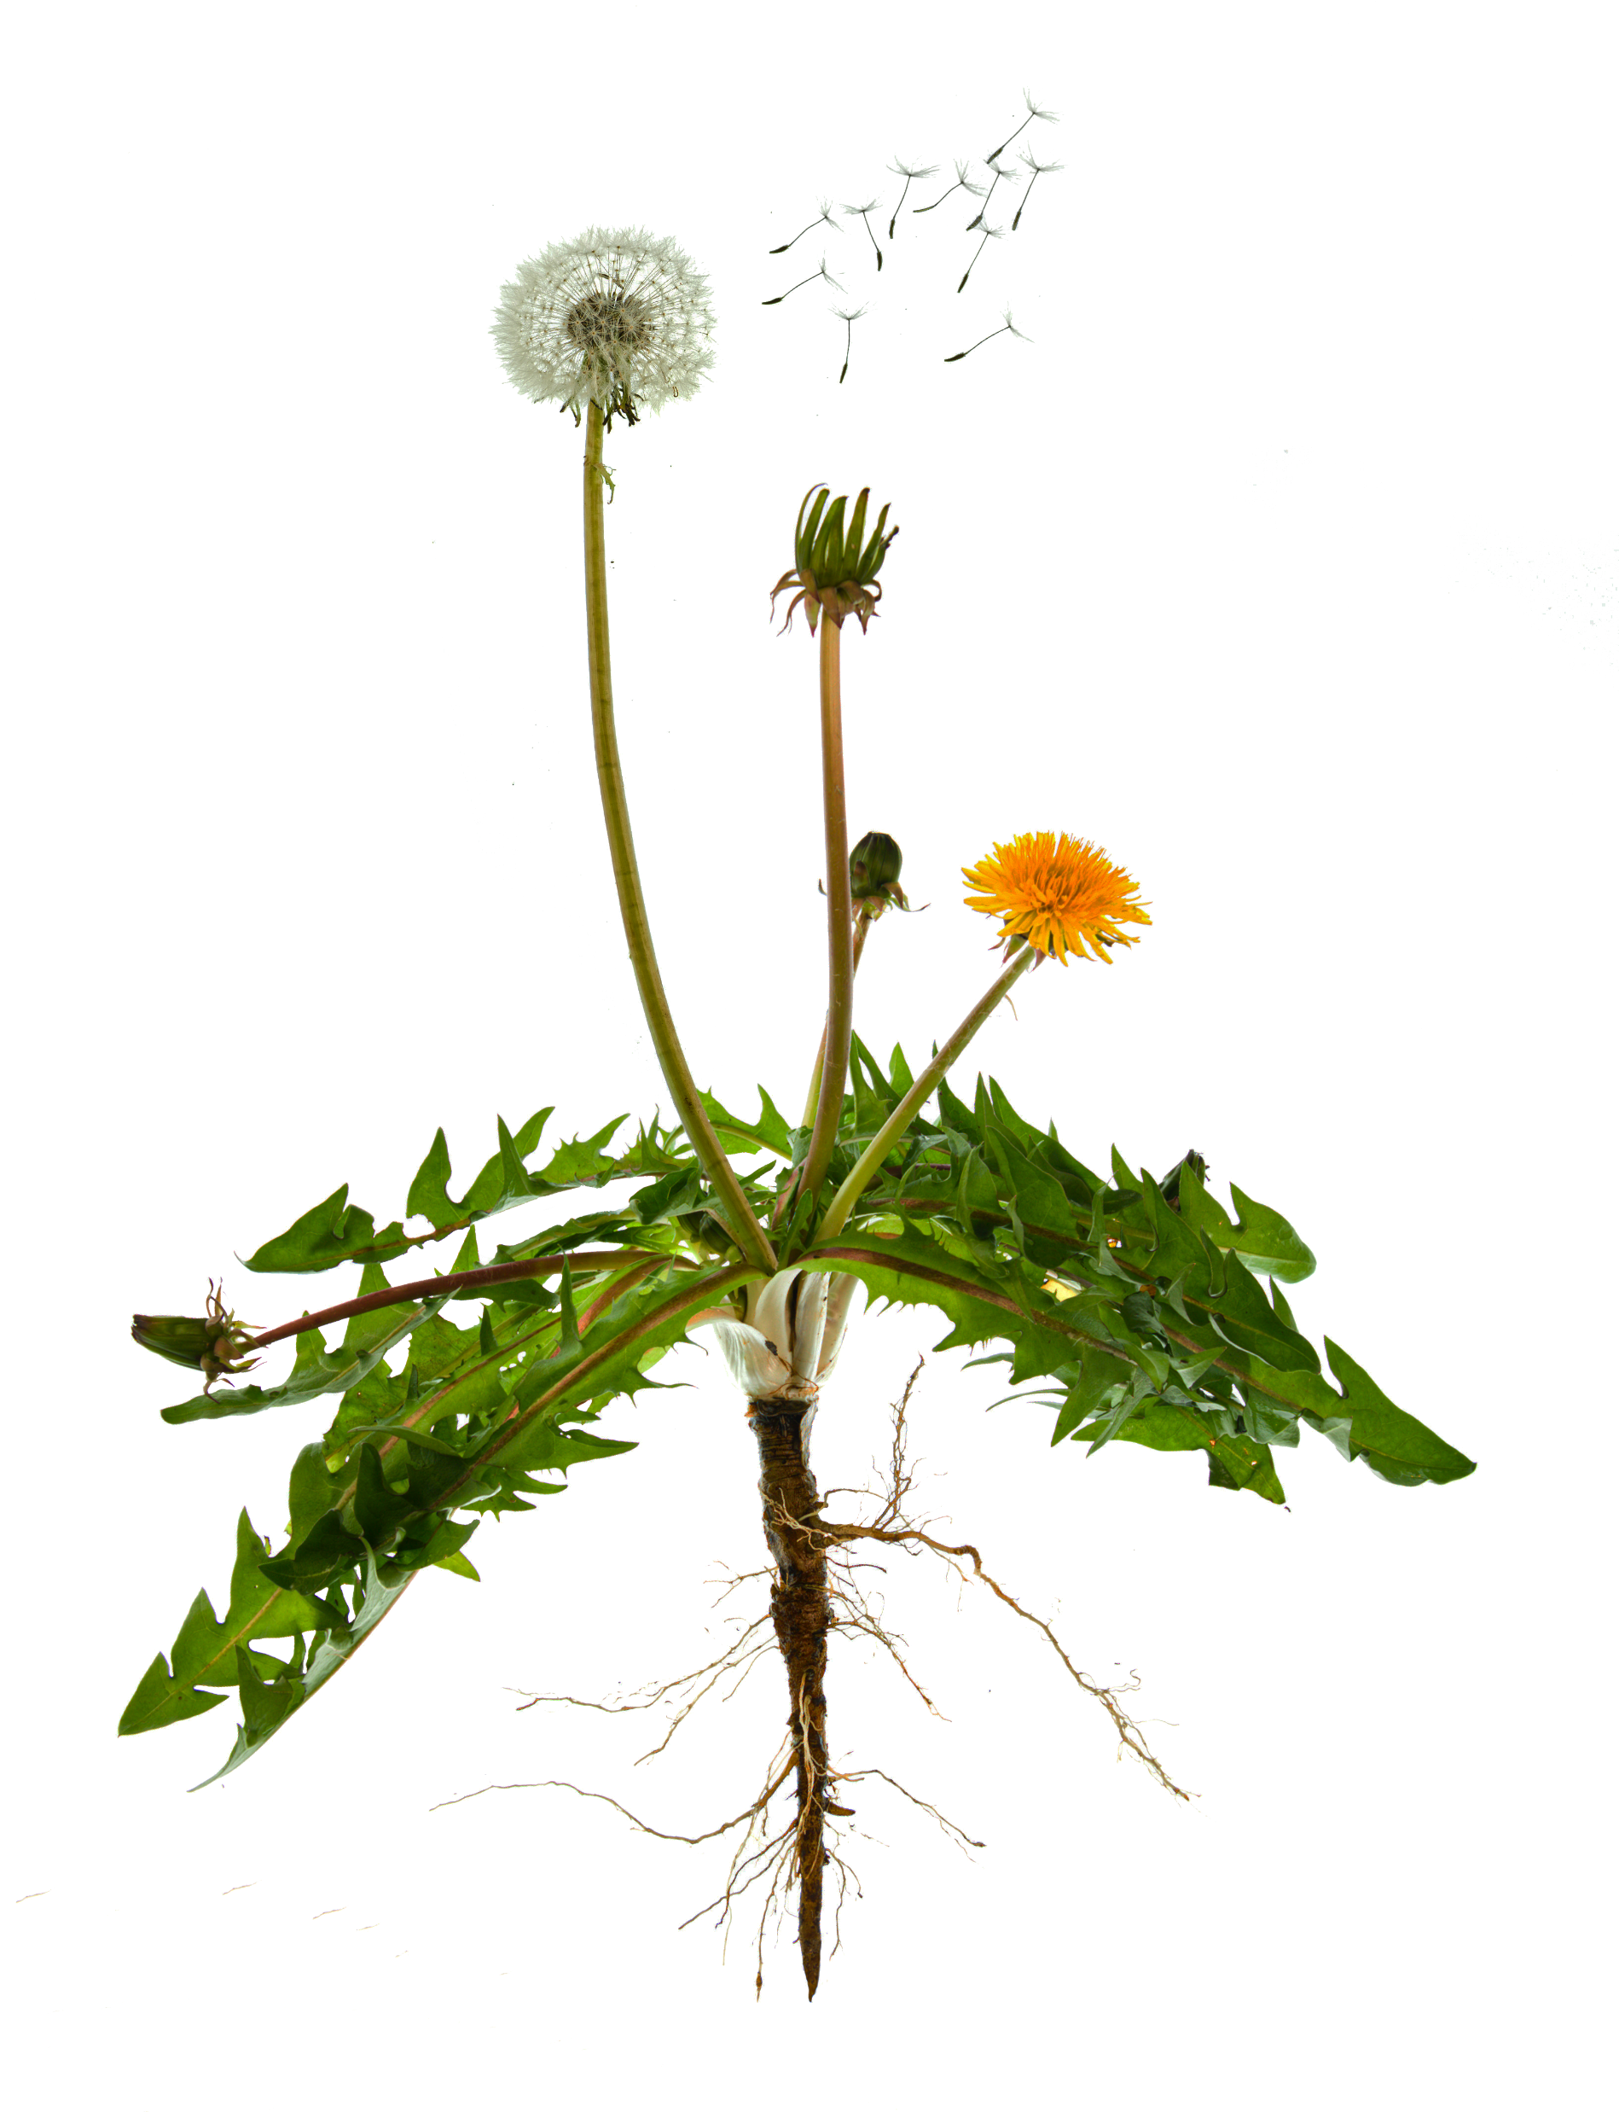
Nutrients
Some of the nutrients plants need to grow
Any substance that living things need to survive and grow. Nutrient concentrations have big impacts on an ecosystem.*
Examples
Nitrogen is a nutrient plants and other living things need to grow, make proteins and repair damage.
Sugars are nutrients that most living things need for energy.
Carbon dioxide
Nitrogen
Phosphorous
Water
Potassium
Notes:
*Nutrients in too-high concentration in soil can affect plants’ uptake of water by osmosis.
Plants also vary in their ability to utilize available nutrients. Fast growing plants like grasses and algae can grow very quickly if they have access to sufficient nutrients. In these situations they can out-compete slower growing species for space, light or nutrients, killing those other species.
In aquatic environments, phosphorous and nitrogen compounds from fertilizers and manure washing into the water body can cause blooms of algae and lead to a process called eutrophication (ew-tri-FI-kay-tion). This is where algae grows so thick it blocks light from reaching other submerged plants, killing them. As the algae cells die, their decomposition takes oxygen out of the water, which kills off many animals in the water body.

